Slide 1
STOR 455 Analysis of Variance and Multiple Regression
Read: 2.2, 3.1, 3.2
Exercises: 2.15a, 17a, 23, 29, 47
3.19 , 20, 21

Slide 2
Test for a Linear Relationship via Correlation
Let ρ (rho) denote the population correlation
H_{o}: ρ=0
H_{a}: ρ≠0
Compare to a t-distribution with n-2 d.f.

Slide 3
Correlation t-test in R
cor.test(lego_under_800_pieces$Pieces, lego_under_800_pieces$Amazon_Price^(0.3))
Pearson's product-moment correlation
data: lego_under_800_pieces$Pieces and lego_under_800_pieces$Amazon_Price^(0.3)
t = 24.699, df = 716, p-value < 2.2e-16
alternative hypothesis: true correlation is not equal to 0
95 percent confidence interval:
0.6367026 0.7159108
sample estimates:
cor
0.6782721
Coefficients:
Estimate Std. Error t value Pr(>|t|)
(Intercept) 2.311e+00 2.949e-02 78.36 <2e-16 ***
Pieces 2.230e-03 9.029e-05 24.70 <2e-16 ***
---
Signif. codes: 0 ‘***’ 0.001 ‘**’ 0.01 ‘*’ 0.05 ‘.’ 0.1 ‘ ’ 1
Residual standard error: 0.4807 on 716 degrees of freedom
(393 observations deleted due to missingness)
Multiple R-squared: 0.4601, Adjusted R-squared: 0.4593
F-statistic: 610.1 on 1 and 716 DF, p-value: < 2.2e-16

Slide 4
Analysis of Variance
=
+
Data
Model
Error
=
+
TOTAL variation in response, Y
Variation explained by MODEL
Unexplained variation in RESIDUALS
Key question: Does the MODEL explain a “significant” amount of the TOTAL variability?

Slide 5
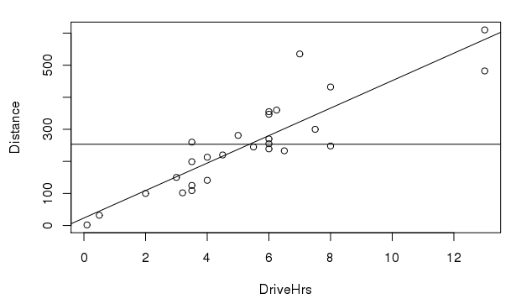

TOTAL variation in response, Y
$$\overline{y}$$
*Not our data. For visualization purposes

Slide 6

Variation explained by MODEL
$$\overline{y}$$
*Not our data. For visualization purposes

Slide 7
Unexplained variation in RESIDUALS
*Not our data. For visualization purposes

Slide 8
Partitioning Variability - SLM
Y
=
β_{o} + β₁X
+
ε
=
+
=
+
=
SSModel
+
SSE
SSTotal

Slide 9
Simple Linear Regression - R
modlego2 = lm(Amazon_Price^(0.3)~Pieces, data=lego_under_800_pieces)
summary(modlego2)
Call:
lm(formula = Amazon_Price^(0.3) ~ Pieces, data = lego_under_800_pieces)
Residuals:
Min 1Q Median 3Q Max
-1.10548 -0.35676 -0.07156 0.25655 2.99219
Coefficients:
Estimate Std. Error t value Pr(>|t|)
(Intercept) 2.311e+00 2.949e-02 78.36 <2e-16 ***
Pieces 2.230e-03 9.029e-05 24.70 <2e-16 ***
---
Signif. codes: 0 ‘***’ 0.001 ‘**’ 0.01 ‘*’ 0.05 ‘.’ 0.1 ‘ ’ 1
Residual standard error: 0.4807 on 716 degrees of freedom
(393 observations deleted due to missingness)
Multiple R-squared: 0.4601, Adjusted R-squared: 0.4593
F-statistic: 610.1 on 1 and 716 DF, p-value: < 2.2e-16

Slide 10
R – ANOVA for a Regression Model
anova(modlego2)
Analysis of Variance Table
Response: Amazon_Price^(0.3)
Df Sum Sq Mean Sq F value Pr(>F)
Pieces 1 140.94 140.938 610.06 < 2.2e-16 ***
Residuals 716 165.41 0.231
---
Signif. codes: 0 ‘***’ 0.001 ‘**’ 0.01 ‘*’ 0.05 ‘.’ 0.1 ‘ ’ 1

Slide 11

ANOVA Test for Regression
Basic idea: Find two estimators of σ_{ε}²
Model ⇒
Compare
Error ⇒
Compare to F-distribution with 1 and $n−2$ d.f.

Slide 12
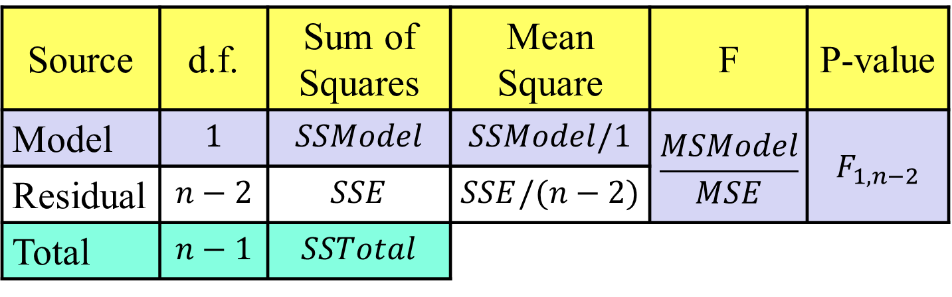


ANOVA Test for Regression
H_{o}: β₁ = 0
H_{a}: β₁ ≠ 0
vs.
($\overline{y}$)
($\hat{y}$)
Source | d.f. | Sum of Squares | Mean Square | F | P-value
Model | $$1$$ | $$SSModel$$ | $$SSModel/1$$ | $$\frac{MSModel}{MSE}$$ | $$F_{1,n−2}$$
Residual | $$n−2$$ | $$SSE$$ | $$SSE/(n−2)$$
Total | $$n−1$$ | $$SSTotal$$
in R use 1-pf(Fstat,1,n-2)

Slide 13
R – ANOVA for a Regression Model
anova(modlego2)
Analysis of Variance Table
Response: Amazon_Price^(0.3)
Df Sum Sq Mean Sq F value Pr(>F)
Pieces 1 140.94 140.938 610.06 < 2.2e-16 ***
Residuals 716 165.41 0.231
> summary(modlego2)
Some output omitted…
Coefficients:
Estimate Std. Error t value Pr(>|t|)
(Intercept) 2.311e+00 2.949e-02 78.36 <2e-16 ***
Pieces 2.230e-03 9.029e-05 24.70 <2e-16 ***
---

Slide 14
What is r²?
r² = proportion of total variability in the response (Y) that is “explained” by the model.
Residual standard error: 0.4807 on 716 degrees of freedom
(393 observations deleted due to missingness)
Multiple R-squared: 0.4601, Adjusted R-squared: 0.4593
F-statistic: 610.1 on 1 and 716 DF, p-value: < 2.2e-16
anova(modlego2)
Df Sum Sq Mean Sq F value Pr(>F)
Pieces 1 140.94 140.938 610.06 < 2.2e-16 ***
Residuals 716 165.41 0.231

Slide 15
Visualizing r² for a SLM
Basic Idea: How much “better” does the least squares line do than a “prediction” that doesn’t use X at all?
Using NO predictor:
Least Squares Line:

Slide 16
SSTotal=211759
$$\overline{y}$$
*Not our data. For visualization purposes

Slide 17
SSE=17342
*Not our data. For visualization purposes

Slide 18
Why is it called r²?
Def: The correlation, r, measures the strength of linear association between two quantitative variables.
-1< r <1
⇒ 0 < r² < 1
Explains no variability
Explains all variability

Slide 19
T-test for slope:
Which is best?
H_{o}: β₁=0
H_{a}: β₁≠0
Compare to t _{n-2}
All three are equivalent!
ANOVA for regression:
H_{o}: β₁=0
H_{a}: β₁≠0
Compare to F_{1,n-2}
T-test for correlation:
(t_{n-2})² = F_{1,n-2}
H_{o}: ρ =0
H_{a}: ρ ≠0
Compare to t _{n-2}

Slide 20
Three Regression Tests in R
Why 3 different tests?
Multiple regression
> summary(modlego2)
Coefficients:
Estimate Std. Error t value Pr(>|t|)
(Intercept) 2.311e+00 2.949e-02 78.36 <2e-16 ***
Pieces 2.230e-03 9.029e-05 24.70 <2e-16 ***
anova(modlego2)
Df Sum Sq Mean Sq F value Pr(>F)
Pieces 1 140.94 140.938 610.06 < 2.2e-16 ***
Residuals 716 165.41 0.231
cor.test(lego_under_800_pieces$Pieces, lego_under_800_pieces$Amazon_Price^(0.3))
t = 24.699, df = 716, p-value < 2.2e-16

Slide 21
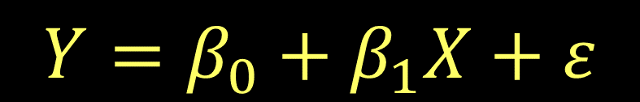
Simple Linear Regression Model
$$Y=β_{0}+β_{1}X+ε$$
where ε ~ N( 0, σ_{ε}) and independent
What if we have more than one potential predictor?

Slide 22

Multiple Regression Model
$$Y=β_{0}+β_{1}X_{1}+β_{2}X_{2}+⋯β_{k}X_{k}+ε$$
$$Y=β_{0}+β_{1}X+ε$$
k predictors
where ε ~ N( 0, σ_{ε}) and independent
Data?
We need n data cases, each with values for Y and all of the predictors X₁,...,X_{k}.

Slide 23
t-test for Correlation
H_{o}: ρ =0
H_{a}: ρ ≠0
No change!
Find p-value with t _{n-2}
Use this to:
Identify potential good predictors of Y.
Look for relationships among predictors.

Slide 24
R - Correlation Matrix
Example: Predict Price of a house based on it Size and size of the Lot.
> data(Houses)
> cor(Houses)
Price Size Lot
Price 1.0000000 0.6848219 0.7157072
Size 0.6848219 1.0000000 0.7668722
Lot 0.7157072 0.7668722 1.0000000

Slide 25
t-test for Correlation
cor.test(Houses$Price, Houses$Size)
cor.test(Houses$Price, Houses$Lot)
cor.test(Houses$Size, Houses$Lot)
> cor.test(Houses$Price, Houses$Size)
Pearson's product-moment correlation
data: Houses$Price and Houses$Size
t = 3.9871, df = 18, p-value = 0.0008643
alternative hypothesis: true correlation is not equal to 0
95 percent confidence interval:
0.3476582 0.8651583
sample estimates:
cor
0.6848219

Slide 26

Prediction Equation
$$\hat{y}={\hat{β}}_{0}+{\hat{β}}_{1}x_{1}+{\hat{β}}_{2}x_{2}+…+{\hat{β}}_{k}x_{k}$$
where the coefficients are chosen to minimize:
$$SSE=∑{\left(y−\hat{y}\right)}^{2}$$
To fit a multiple regression in R:
model=lm(y~pred1+pred2+pred3,data= )

Slide 27
R - Multiple Regression
> HouseModel=lm(Price~Size+Lot,data=Houses)
> summary(HouseModel)
Call:
lm(formula = Price ~ Size + Lot, data = Houses)
Coefficients:
Estimate Std. Error t value Pr(>|t|)
(Intercept) 34121.649 29716.458 1.148 0.2668
Size 23.232 17.700 1.313 0.2068
Lot 5.657 3.075 1.839 0.0834 .
---
Residual standard error: 47400 on 17 degrees of freedom
Multiple R-squared: 0.5571, Adjusted R-squared: 0.505
F-statistic: 10.69 on 2 and 17 DF, p-value: 0.000985
$$\hat{Price}=34121.6+23.232∙Size+5.657∙Lot$$

Slide 28
T-test for Slope
Note: We now have multiple “slopes” to test
All given in R with a p-value
H_{o}: β_{i}=0
H_{a}: β_{i}≠0
Compare to t _{n-k-1}
lose 1 d.f. for each coefficient
Reject H_{o}⬄The i^{th} predictor is useful in this model

Slide 29
R Regression: Individual T-tests
> summary(modelH)
Call:
lm(formula = Price ~ Size + Lot)
Estimate Std. Error t value Pr(>|t|)
(Intercept) 34121.649 29716.458 1.148 0.2668
Size 23.232 17.700 1.313 0.2068
Lot 5.657 3.075 1.839 0.0834 .
---
Residual standard error: 47400 on 17 degrees of freedom
Multiple R-squared: 0.5571, Adjusted R-squared: 0.505
F-statistic: 10.69 on 2 and 17 DF, p-value: 0.000985

Slide 30
Coefficient of Multiple Determination
Now interpreted as the % of variability in the response variable (Y) that is “explained” by a linear combination of these predictors.

Slide 31
t-test for Correlation vs. t-test for Slope
t-test for correlation: Assesses the linear association between two variables by themselves.
t-test for slope: Assesses the linear association after accounting for the other predictors in the model.

Slide 32
Partitioning Variability
Y
=
β_{o}+β₁X₁+…+β_{k}X_{k}
+
ε
=
SSModel
+
SSE
SSTotal
“Explained” by regression
+
Error after regression
Total variability in Y

Slide 33

ANOVA test for Overall Fit
weak model
H_{o}: β₁= β₂=...=β_{k}= 0
H_{a}: Some β_{i} ≠ 0
effective model
Source | d.f. | Sum of Squares | Mean Square | t.s. | P-value
Model | $$1$$ | $$SSModel$$ | $$SSModel/1$$ | $$\frac{MSModel}{MSE}$$ | $$F_{1,n−2}$$
Residual | $$n−2$$ | $$SSE$$ | $$SSE/(n−2)$$
Total | $$n−1$$ | $$SSTotal$$
k
k
F_{k,n-k-1}
n-k-1
(n-k-1)

Slide 34
R - Regression ANOVA
> anova(HouseModel)
Analysis of Variance Table
Response: Price
Df Sum Sq Mean Sq F value Pr(>F)
Size 1 4.0447e+10 4.0447e+10 18.0018 0.0005485 ***
Lot 1 7.6013e+09 7.6013e+09 3.3831 0.0833990 .
Residuals 17 3.8196e+10 2.2468e+09
Important note: R shows a “sequential” sum of squares in the ANOVA table, i.e. how much new variability is explained as each predictor is added. Add the components to find the SSModel.

Slide 35
A “Local” ANOVA Function
To find ANOVA for a multiple regression model that is NOT split sequentially for each predictor…
> anova455(HouseModel)
ANOVA Table
Model: Price ~ Size + Lot
Df Sum Sq Mean Sq F value P(>F)
Model 2 4.8048e+10 2.4024e+10 10.693 0.000985 ***
Error 17 3.8196e+10 2.2468e+09
Total 19 8.6244e+10
---
Signif. codes: 0 ‘***’ 0.001 ‘**’ 0.01 ‘*’ 0.05 ‘.’ 0.1 ‘ ’ 1

Slide 36
Example: Houses
Test #1: Compute and test the correlation between Size and Lot in Houses
cor.test(Houses$Size, Houses$Lot)
t = 5.0694, df = 18, p-value = 7.991e-05
Test #2: Compute and test the coefficient of Size in a multiple regression model (along with Lot) to predict Price.
(Estimate Std Error t value Pr(>|t|)
Intercept) 34121.649 29716.458 1.148 0.2668
Size 23.232 17.700 1.313 0.2068
Lot 5.657 3.075 1.839 0.0834
F-statistic: 10.69 on 2 and 17 DF, p-value: 0.000985
What’s going on?

